Slide 1

QUESTION GENERATION SYSTEM

Slide 2
Team Members
Project Guide :-
BY : Mithun R Sanjay P Gopikandhar R Suman S
Dr. Marikkannu P M.Tech, PhD, Department of Computer science and Engineering
Anna University Regional Campus, Coimbatore

Slide 3
Introduction
Large documents pose challenges for question answering systems due to complexity, information organization, and answer accuracy. QA systems are transforming information access and various fields, and your project aims to develop an AI-powered QA generator for automatic answer generation.

Slide 4
Abstract
This project introduces an innovative QA system employing prompt engineering to generate precise questions from diverse paragraph sources, utilizing a pretrained model based on the Bert and T5 architecture. Through machine learning algorithms, it processes user inputs, extracts relevant keywords, and maps them to specific multiple-choice questions (MCQs). The aim is to enhance QA system efficiency and accuracy by leveraging advanced natural language processing and AI techniques, focusing on crafting effective prompts for comprehensive answers.

Slide 5
Existing system
Automated Question Generator & Summarizer using BERT by Prachijainan is an automated MCQ generator and summarizer that leverages BERT (Bidirectional Encoder Representations from Transformers), a powerful NLP algorithm from Google. The system addresses the time-consuming task of creating numerous MCQs for assessments. It uses BERT to automatically generate MCQs from any given content and employs WordNet to construct distractor options. In essence, it helps computers gain a more human-like understanding of language to automate MCQ creation and summarize text.

Slide 6
Literature Survey
Paper Title | Paper focus | Reference link
Adversarial and Safely Scaled Question Generation from Text Using Transformers | This paper explores usingTransformer-based models for question generation from text documents. | https://arxiv.org/pdf/221009467
Training Conversational Question Answering with Limited Data | This paper explores training question generation models with limited data for conversational settings. | https://arxiv.org/pdf/2204.04581
Automatic Question Generation for Repeated Testing to Improve Student Learning Outcome: | This paper focuses on the application of automatic question generation in education, using recurrent neural networks to generate questions for testing purposes | https://ieeexplore.ieee.org/iel7/9499715/9499717/09499754.pdf

Slide 7
Proposed work
Uses State of art NLP technique such as Transformers ,
the model learned to predict the next word of the text using Attention mechanism.
Able to handle large amount of data and generate Questions (Mcq) based on the trained data.

Slide 8
Model Used
T5 and Bert emerges as a powerful tool for tackling your English question answering tasks. This open-source gem leverages the fine-tuning magic of the SQuAD 2.0 dataset, allowing it to extract precise and factual answers from your text. While boasting impressive accuracy, it maintains a snappy pace thanks to its base model architecture. This perfect blend of speed and precision makes roberta-base-squad2 a versatile asset for a wide range of projects.

Slide 9
Technique
This project accepts a paragraph as input and processes it using a Transformer application. Initially, the input paragraph is converted into keywords through keyword generation. Subsequently, specific keywords relevant to forming questions are chosen based on the model's processing. Leveraging question mapping, these keywords are transformed into questions, eventually leading to the generation of multiple-choice questions (MCQs). Throughout this process, the model selectively utilizes targeted keywords to create appropriate and engaging MCQs aligned with the source paragraph.

Slide 10
Algorithm used
Text Cleaning (Haystack Utilities)
TF-IDF Retrieval (T find Retriever)
Term Frequency (TF)
Inverse Document Frequency (IDF)
TF-IDF Score
Extractive Question Answering (FARM Reader)
Keyphrase Extraction
Question Formulation
Answer Selection

Slide 11
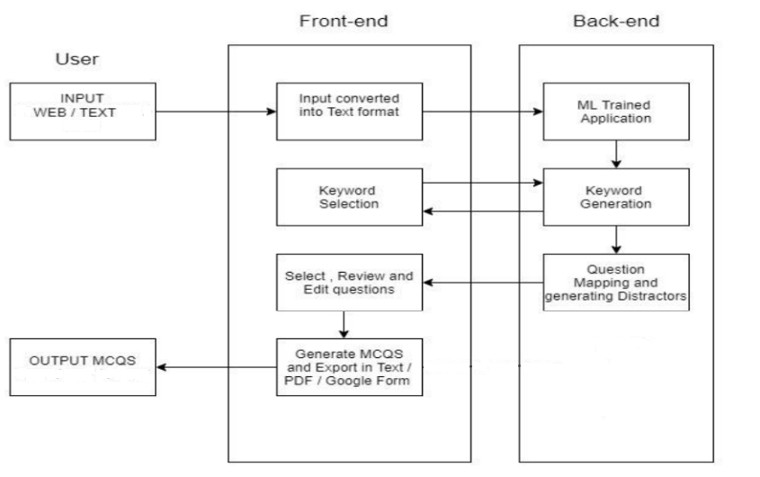
Architectural Diagram

Slide 12
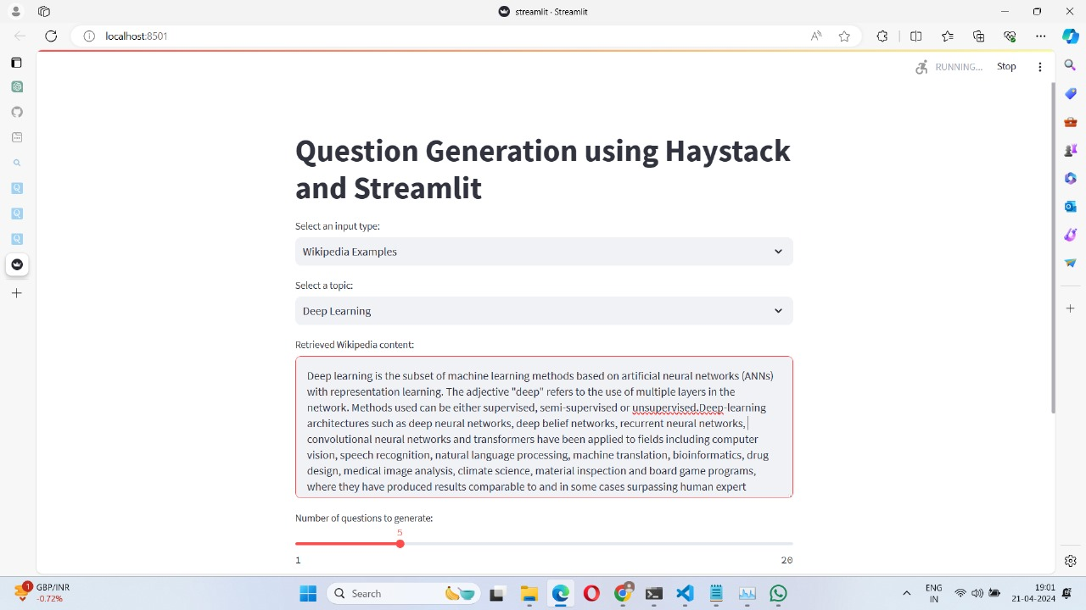
Outcome

Slide 13
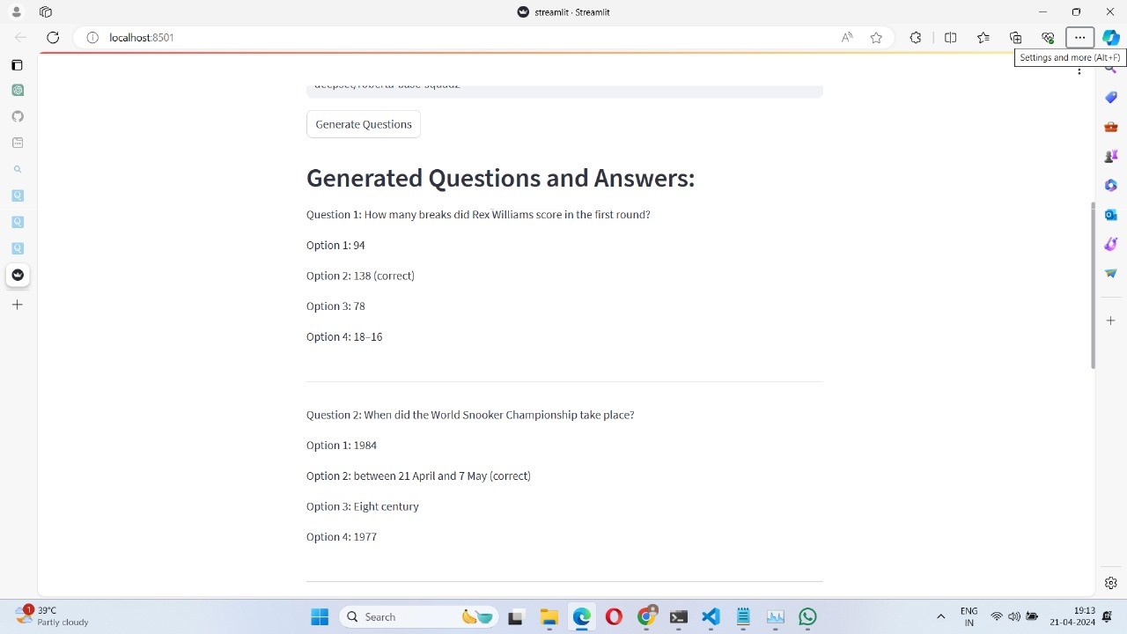
Outcome

Slide 14
Benefits
Boost Factual Accuracy:
This model excels at extracting key factual points from text passages. By integrating it, you can ensure your MCQs accurately reflect the information presented. This leads to higher quality questions that effectively test comprehension.
Enhance Question Variety:
This system help you generate diverse MCQs beyond simple recall. It can identify important details and concepts, allowing you to craft questions that test analysis, application, and evaluation skills. This promotes deeper understanding of the subject matter.

Slide 15
Future Enhancement
Imagine seamlessly integrating your system into online exam platforms. This would allow educators to create assessments with diverse question types, catering to different learning styles and fostering a more engaging exam experience.
Online Exam
Integration :
Consider implementing a system that adjusts question difficulty based on the complexity of the input paragraph. This ensures students are challenged appropriately.
Adaptability :
Integrate mechanisms to highlight relevant parts of the paragraph that justify the correct answer choice in MCQs. This provides valuable feedback and reinforces learning. For open-ended questions, consider offering answer frameworks or guiding prompts.
Explanation & Feedback :

Slide 16
Reference
Hugging Face Transformers: https://huggingface.co/docs/transformers/en/index - This library provides pre-trained models for various NLP tasks, including question generation models like BART. It also offers tools for fine-tuning these models onyour own data.
Streamlit: https://streamlit.io/ - Another framework for building user interfaces for data science applications. You can leverage Streamlit to create a user-friendly interface for interacting with your question generation system.

Slide 17
Blogs and Articles: "Question Generation with Transformers" by Hugging Face: https://huggingface.co/models?other=question-generation - This blog post provides a tutorial on using Hugging Face Transformers for question generation.
Training Conversational Question Answering with Limited Data" by Wu et al. (2020): https://arxiv.org/pdf/2204.04581 - This paper explores training question generation models with limited data for conversational settings.
"REAL: Realistic and Explainable Adversarial Loss for Question Generation" by Liu et al. (2021): https://arxiv.org/pdf/1912.04497 - This paper proposes a novel loss function for improving the realism and explainability of generated questions byLLMs.

Slide 18

Thank you

